Slide 1
Lecture 10 2-3 Trees B Trees
Department of Computer Science
Hofstra University

Slide 2

2−3 Trees
Allow 1 or 2 keys per node
2-node: one key, two children.
3-node: two keys, three children.
Perfect balance: Every path from root to leaf has same length.
Symmetric order: In-order traversal yields keys in ascending order.
Search
Compare search key against keys in node.
Find interval containing search key.
Follow associated link (recursively).
3-node
M
2-node
smaller than E
E J
R
larger than J
Search for H
H is less than M (go left)
Search hit
A C
H
L
P
S X
H is between E and J (go middle)
Search for B
B is less than M (go left)
Search miss
between E and J
B is less than E (go left)
B is between A and C (go middle)
Link is null
2

Slide 3
Insert in 2−3 Trees
Insertion into a 2-node at bottom.
Search for key, as usual
Add new key to 2-node to create a 3-node.
Insert K
K is less than M (go left)
K is larger than J (go right)
K is less than L
M
Search ends here and replace 2-node with 3-node containing K
R X
E J
R
Insert Z
Z is larger than M (go right)
A C
K L
Z is larger than R (go right)
H
L
P
S X
S Z
S X Z
S
Z
Z is larger than X
Search ends here
Replace 3-node with temporary 4-node containing Z
Split 4-node into two 2-nodes (pass middle key to parent)
Insertion into a 3-node at bottom.
Add new key to 3-node to create temporary 4-node.
Move middle key in 4-node into parent.

Slide 4
Insert in 2−3 Trees (Contd.)
Insertion into a 3-node at bottom.
Add new key to 3-node to create temporary 4-node.
Move middle key in 4-node into parent.
Repeat up the tree, as necessary.
If you reach the root and it's a 4-node, split it into three 2-nodes.
Insert L
L is between E and R (go middle)
Search ends here
Replace 3-node with temporary 4-node containing L
E R
Split 4-node (move L to parent)
H L P
S X
A C
H P
Height of tree increases by 1
L
Split 4-node (move L to parent)
E R
E L R
E
R
A C
H
P
S X
A C
H
P
S X

Slide 5
2−3 Trees Construction
Insert S
Create 2-node in the empty tree
Insert H
Convert 3-node into 4-node
Insert E
Convert 2-node into 3-node
Split 4-node into two 2-nodes (move R to parent)
Insert A
Convert 3-node into 4-node
Insert X
Convert 2-node into 3-node
Split 4-node into two 2-nodes (move E to parent)
Insert P
Convert 2-node into 3-node
Insert R
Convert 2-node into 3-node
Insert L
Convert 3-node into 4-node
Insert C
Convert 2-node into 3-node
Split 4-node into two 2-nodes (move L to parent)
Split 4-node into two 2-nodes (move L to parent)
E L R
E R
L
E S
A E S
A C
H P
S X
E
R
H L P
H P
A C
H
P
S X
E R
E
E L R
E R
A C
H R S
H S
R S
Create a new root node, and height of the tree grows by one
A C
H
P
S X

Slide 6
Local Transformations in a 2-3 Tree
Converting a 2-node to a 3-node
Converting a three to a four, and then splitting and passing a node up
a e
b c d
These operations maintain tree balance.
local transformation: constant number of operations.
less than a
between
a and b
between
b and c
between
c and d
between
d and e
greater than e
Only involves changing a constant number of links, and is independent of the tree size.
a c e
b
d
less than a
between
a and b
between
b and c
between
c and d
between
d and e
greater than e

Slide 7








Global Properties in a 2-3 Tree
Invariants. Maintains symmetric order and perfect balance.
Proof. Each transformation maintains symmetric order and perfect balance.
Splitting a 4-node
parent is a 3-node: split and parent turns into a 4-node; parent splits again (omitted in figures)
root
a b c
b
left
d e
b d e
a
c
a b c
a
c
parent is a 2-node: split and parent turns into a 3-node
middle
a e
a c e
left
d
b d
b c d
b
d
a b c
a
c
right
a b
a b d
right
a
a c
c d e
c
e
b c d
b
d
If it is perfect balance before, it is perfect balance afterwards

Slide 8
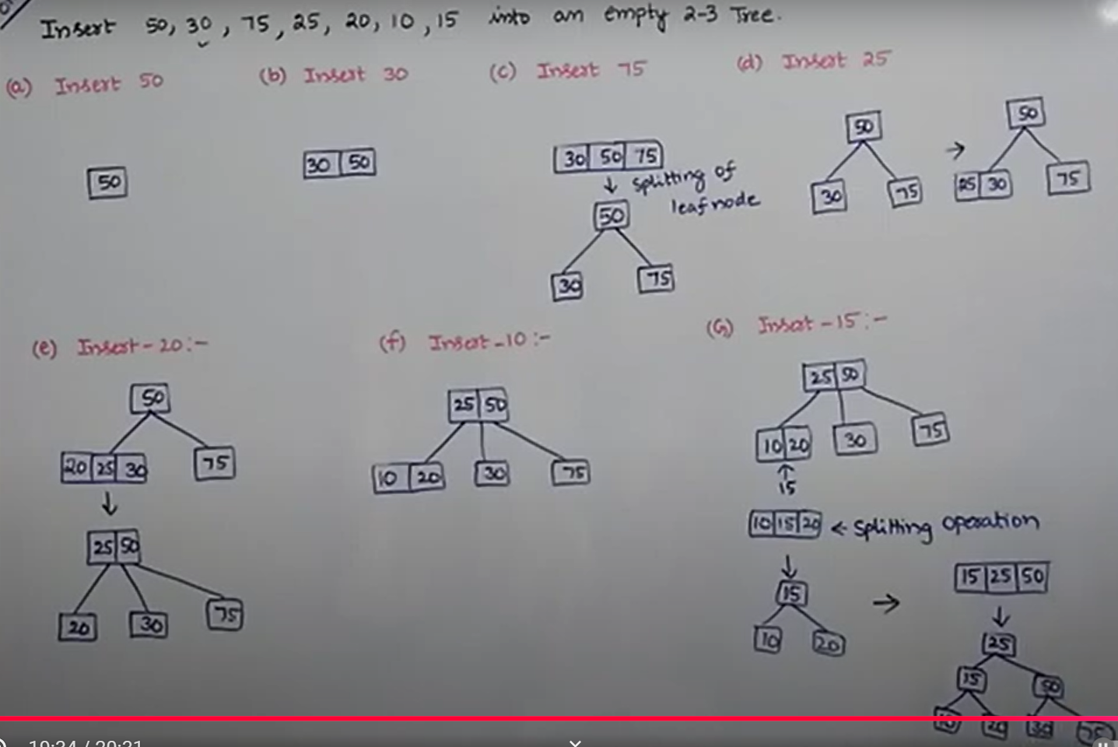
EXAMPLE PROBLEM ON 2-3 TREE INSERTION
EXAMPLE PROBLEM ON 2-3 TREE INSERTION, DIVVELA SRINIVASA RAO
https://www.youtube.com/watch?v=2S5Ld-FQ2dM

Slide 9

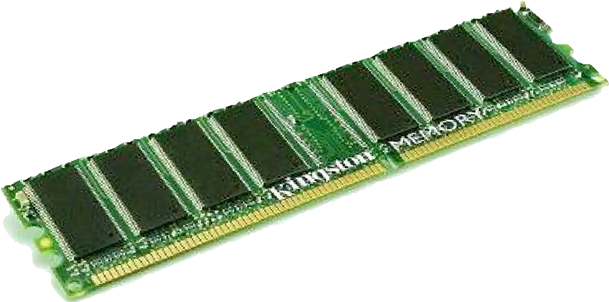
Motivation for B-tree: File system model
Page. Contiguous block of data (e.g., a file or 4,096-byte chunk). Probe. First access to a page (e.g., from disk to memory).
slow
fast
Property. Time required for a probe is much larger than time to access data within a page.
Cost model. Number of probes.
Goal. Access data using minimum number of probes.

Slide 10
Motivation for B-Trees
Index structures for large datasets cannot be stored in main memory, hence must be stored on disk
Time required to access disk is much larger than time to access main memory
Goal: access data with minimum number of probes.

Slide 11
Motivation (cont.)
Assume that we use an AVL tree to store about 20 million records
We end up with a very deep binary tree with lots of different disk accesses, e.g., log₂ 20,000,000 is about 24
We know we cannot improve on the log n lower bound on search for a binary tree
But we can use more branches and thus reduce the height of the tree!
As branching increases, depth decreases

Slide 12
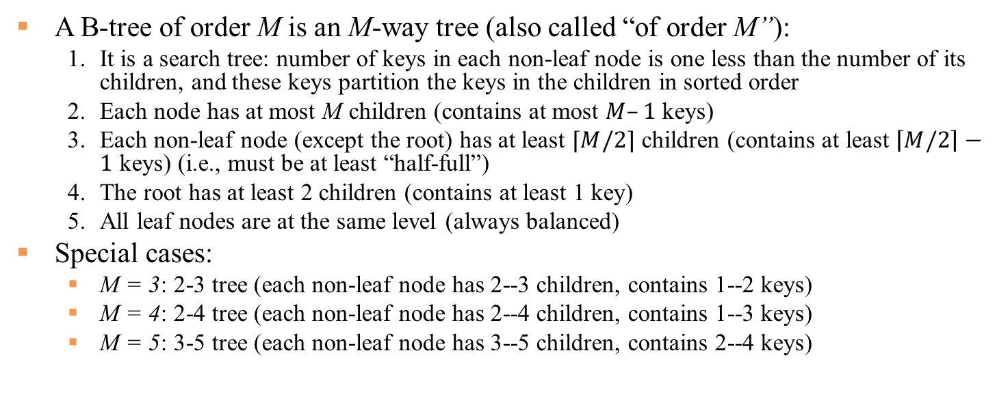
Definition of a B-tree
A B-tree of order M is an M-way tree (also called “of order M”):
1. It is a search tree: number of keys in each non-leaf node is one less than the number of its children, and these keys partition the keys in the children in sorted order
2. Each node has at most M children (contains at most $M–1$ keys)
3. Each non-leaf node (except the root) has at least $⌈M/2⌉$ children (contains at least $\left\lceil M/2\right\rceil −1$ keys) (i.e., must be at least “half-full”)
4. The root has at least 2 children (contains at least 1 key)
5. All leaf nodes are at the same level (always balanced)
Special cases:
M = 3: 2-3 tree (each non-leaf node has 2--3 children, contains 1--2 keys)
M = 4: 2-4 tree (each non-leaf node has 2--4 children, contains 1--3 keys)
M = 5: 3-5 tree (each non-leaf node has 3--5 children, contains 2--4 keys)
3
7
12
21
x<3
3≤x<7
7≤x<12
12≤x<21
21≤x
Notes:
i.e., a tree where each node may have up to M children,
Every leaf has the same depth
In a B-tree of a degree t, all nodes except the root node have between t and 2t children (i.e., between t - 1 and 2t - 1 keys)
The root node has between 0 and 2t children (i.e., between 0 and 2t - 1 keys
(unless it is also a leaf node)
If we take m = 3, we get a 2-3 tree, in which non-leaf nodes have two or three children (i.e., one or two keys)
Choose M as large as possible so that M links fit in a page, e.g., M = 1024
The number M should always be odd.

Slide 13
B-trees Example I
Generalization of 2-3 trees
At least 2 children at root
At least ⎡M / 2⎤ children in other nodes
26
6
12
42
51
62
1
2
4
7
8
13
15
18
25
27
29
45
46
48
53
55
60
64
70
90
A B-tree of order 5 (M = 5)
All leaves are at the same level 3

Slide 14
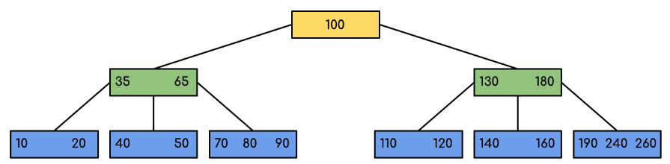
B-trees Example II
Generalization of 2-3 trees
At least 2 children at root
At least ⎡M / 2⎤ children in other nodes
A B-tree of order 4 (M = 4)
All leaves are at the same level 3
Notes:
External nodes contain client keys.
Internal nodes contain copies of keys to guide search.

Slide 15
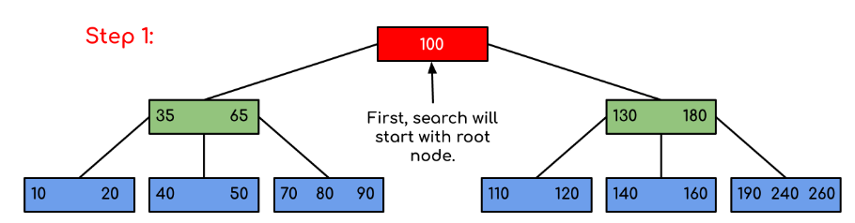
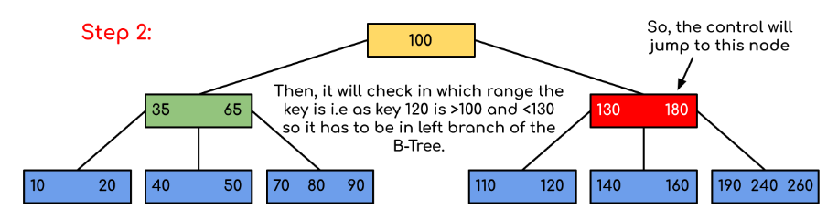
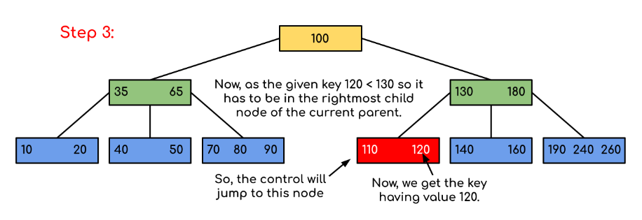
Searching for 120 in the given B-Tree
Notes:
https://spetriuk.github.io/algorithms/B-Tree.%201.%20Introduction/

Slide 16
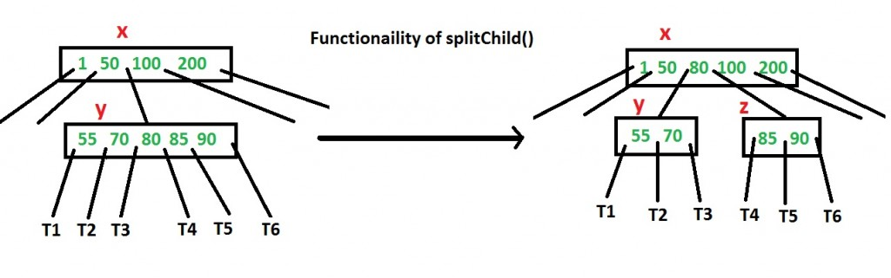
Inserting into a B-Tree
Attempt to insert the new key into a leaf
If this would result in that leaf becoming too big, split the leaf into two, promoting the middle key to the leaf’s parent
If this would result in the parent becoming too big, split the parent into two, promoting the middle key
This strategy might have to be repeated all the way to the top
If necessary, the root is split in two and the middle key is promoted to a new root, making the tree one level higher

Slide 17
Constructing a B-tree
Suppose we start with an empty B-tree and keys arrive in the following order:1 12 8 2 25 5 14 28 17 7 52 16 48 68 3 26 29 53 55 45
We want to construct a B-tree of order 5
The first four keys go into the root:
To put the fifth key in the root would violate condition 5
Therefore, when 25 arrives, promote the middle key to make a new root
1
2
8
12

Slide 18
Constructing a B-tree (contd.)
8
1
2
12
25
6, 14, 28 get added to the leaf nodes:
8
1
2
6
12
14
25
28

Slide 19
Constructing a B-tree (contd.)
Adding 17 to the right leaf node would over-fill it, so we take the middle key, promote it (to the root) and split the leaf
8
17
1
2
6
12
14
25
28
7, 52, 16, 48 get added to the leaf nodes
8
17
1
2
6
7
12
14
16
25
28
48
52

Slide 20
Constructing a B-tree (contd.)
Adding 68 causes us to split the right most leaf, promoting 48 to the root, and adding 3 causes us to split the left most leaf, promoting 3 to the root
3
8
17
48
1
2
6
7
12
14
16
25
28
52
68
26, 29, 53, 55 then go into the leaves
3
8
17
48
1
2
6
7
12
14
16
25
26
28
29
52
53
55
68

Slide 21
Constructing a B-tree (contd.)
Adding 45 causes a split of
25
26
28
29
and promoting 28 to the root then causes the root to split
17
3
8
28
48
1
2
6
7
12
14
16
25
26
29
45
52
53
55
68

Slide 22
Deletion from a B-tree
(B-tree deletion will NOT be covered in exam)
During insertion, the key always goes into a leaf. For deletion we wish to remove from a leaf. There are three possible ways we can do this:
1 - If the key is already in a leaf node, and removing it doesn’t cause that leaf node to have too few keys, then simply remove the key to be deleted.
2 - If the key is not in a leaf then it is guaranteed (by the nature of a B-tree) that its predecessor or successor will be in a leaf -- in this case we can delete the key and promote the predecessor or successor key to the non-leaf deleted key’s position.

Slide 23
Explanations: why a key’s predecessor or successor is guaranteed to be in a leaf
Definition of Predecessor and Successor:
The predecessor of a key in an internal node is the largest key in its left subtree.
The successor is the smallest key in its right subtree
Traversal to Leaves:
To find the predecessor, you follow the rightmost path from the left child of the key's node. Similarly, to find the successor, you follow the leftmost path from the right child. These paths always terminate at a leaf because B-trees are structured such that all keys in any subtree are stored in its leaves or internal nodes, and traversal through children eventually reaches leaves
Key Replacement During Deletion:
When deleting a key from an internal node, it is replaced by either its predecessor or successor. This ensures that the B-tree remains balanced and satisfies its properties. Since predecessors and successors are located in leaf nodes, their removal does not disrupt the tree's structure beyond localized adjustments
Ref. Slide 28, “Deletion from a BST” in Lecture 8-Binary Search Tree.

Slide 24
Deletion from a B-tree (2)
If (1) or (2) lead to a leaf node containing less than the minimum number of keys then we look at the siblings immediately adjacent to the leaf in question:
3: if one of them has more than the min. number of keys then we can promote one of its keys to the parent and take the parent key into our lacking leaf
4: if neither of them has more than the min. number of keys then the lacking leaf and one of its neighbours can be combined with their shared parent (the opposite of promoting a key) and the new leaf will have the correct number of keys; if this step leave the parent with too few keys then we repeat the process up to the root itself, if required

Slide 25
Type #1: Simple leaf deletion
Assuming a 5-way
B-Tree, as before...
12
29
52
2
7
9
15
22
31
43
56
69
72
Delete 2: Since there are enough
keys in the node, just delete it

Slide 26
Type #2: Simple non-leaf deletion
12
29
52
56
Delete 52
7
9
15
22
31
43
56
69
72
Borrow the predecessor
or (in this case) successor

Slide 27
Type #4: Too few keys in node and its siblings
12
29
56
Join back together
7
9
15
22
31
43
69
72
Too few keys! Apply Case 4
Delete 72

Slide 28
Type #4: Too few keys in node and its siblings
12
29
7
9
15
22
31
43
56
69

Slide 29
Type #3: Enough siblings
12
29
Demote root key and
promote leaf key
7
9
15
22
31
43
56
69
Delete 22

Slide 30
Type #3: Enough siblings
12
31
7
9
15
29
43
56
69

Slide 31
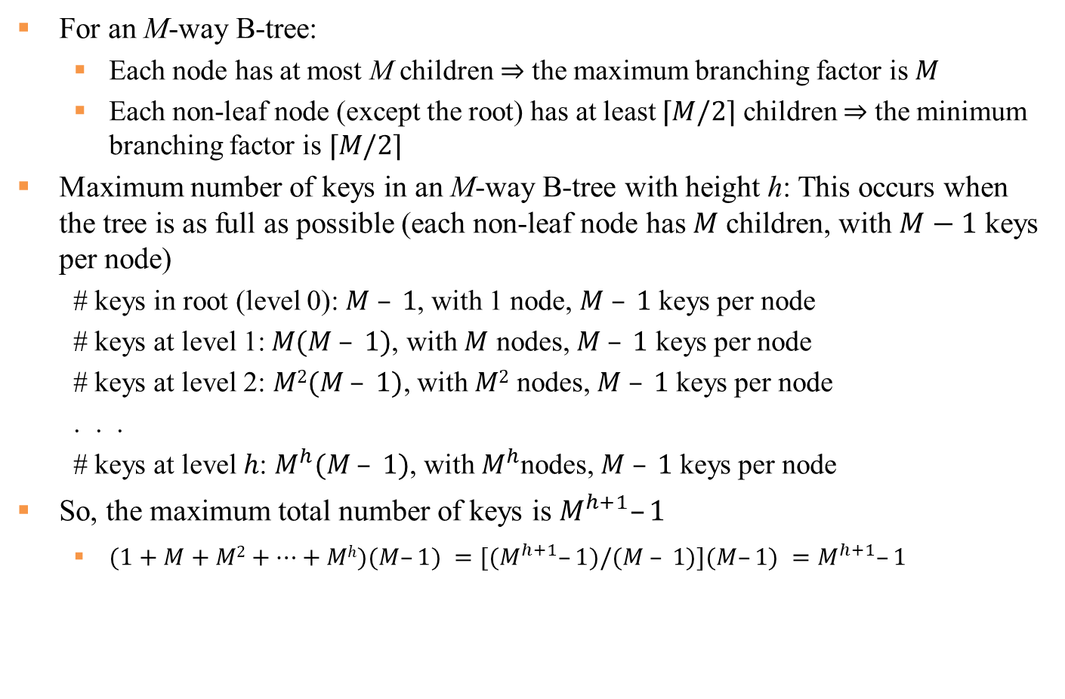
Analysis of B-Trees I
For an M-way B-tree:
Each node has at most M children ⇒ the maximum branching factor is 𝑀
Each non-leaf node (except the root) has at least $⌈M/2⌉$ children ⇒ the minimum branching factor is $⌈M/2⌉$
Maximum number of keys in an M-way B-tree with height h: This occurs when the tree is as full as possible (each non-leaf node has 𝑀 children, with $M−1$ keys per node)
# keys in root (level 0): $M – 1$, with 1 node, $M – 1$ keys per node
# keys at level 1:$M(M – 1)$, with $M$ nodes, $M – 1$ keys per node
# keys at level 2: $M2(M – 1)$, with $M2$ nodes, $M – 1$ keys per node
. . .
# keys at level $h$: $M^{h}(M – 1)$, with $M^{h}$nodes, $M – 1$ keys per node
So, the maximum total number of keys is $M^{h+1}–1$
$(1+M+M2+…+Mh)(M–1) =[(M^{h+1}–1)/(M – 1)](M–1) =M^{h+1}–1$
Notes:
Worst case: log₂ n. (all 2-nodes)
Best case: log₃ n $≈$ 0.631 log₂ n. (all 3-nodes)

Slide 32
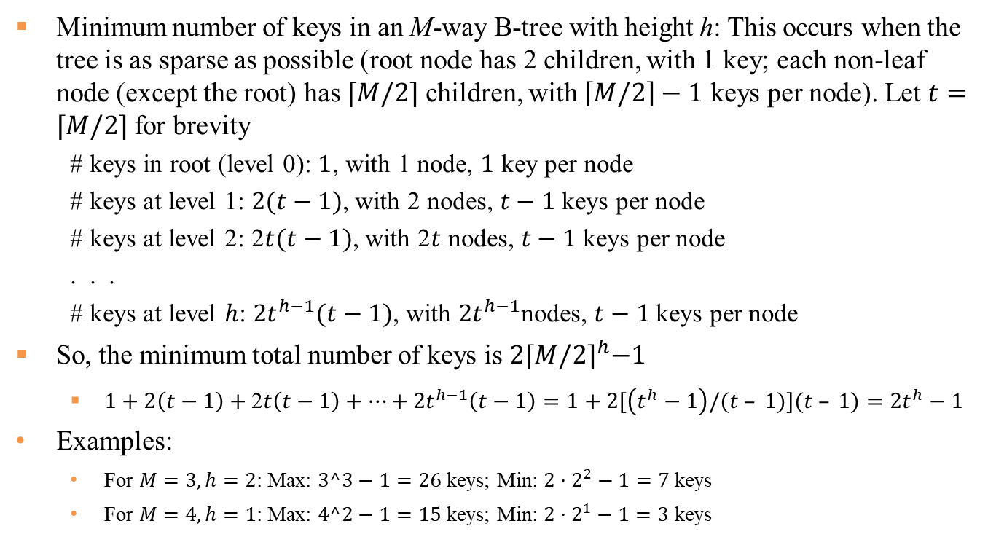
Analysis of B-Trees II
Minimum number of keys in an M-way B-tree with height h: This occurs when the tree is as sparse as possible (root node has 2 children, with 1 key; each non-leaf node (except the root) has $⌈M/2⌉$ children, with $\left\lceil M/2\right\rceil −1$ keys per node). Let $t=⌈M/2⌉$ for brevity
# keys in root (level 0): $1$, with 1 node, $1$ key per node
# keys at level 1: $2(t−1)$, with 2 nodes, $t−1$keys per node
# keys at level 2: 2$t(t−1)$, with 2$t$ nodes, $t−1$keys per node
. . .
# keys at level $h$: ${2t}^{h−1}(t−1)$, with ${2t}^{h−1}$nodes, $t−1$keys per node
So, the minimum total number of keys is $2{⌈M/2⌉}^{h}−1$
$1+2\left(t−1\right)+\text{2}t\left(t−1\right)+…+{2t}^{h−1}\left(t−1\right)=1+2[\left(t^{h}−1\right)/(t – 1)](t – 1)=2t^{h}−1$
Examples:
For $M=3, h=2$: Max: $3^3−1=26$ keys; Min: $2⋅2^{2}−1=7$ keys
For $M=4, h=1$: Max: $4^2−1=15$ keys; Min: $2⋅2^{1}−1=3$ keys

Slide 33
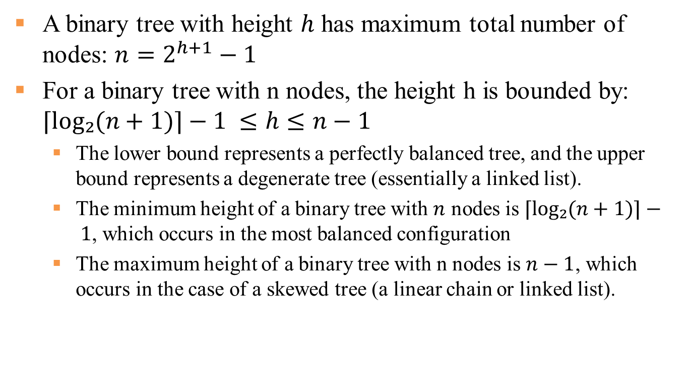
Recall: Height of a Binary Tree
A binary tree with height $h$ has maximum total number of nodes: $n=2^{h+1}−1$
For a binary tree with n nodes, the height h is bounded by: $⌈log₂(n+1)⌉−1 ≤h≤n−1$
The lower bound represents a perfectly balanced tree, and the upper bound represents a degenerate tree (essentially a linked list).
The minimum height of a binary tree with $n$ nodes is $⌈log₂(n+1)⌉− 1$, which occurs in the most balanced configuration
The maximum height of a binary tree with n nodes is $n−1$, which occurs in the case of a skewed tree (a linear chain or linked list).
33
Notes:
The height of a tree is equivalent to the maximum depth of any node in the tree.

Slide 34











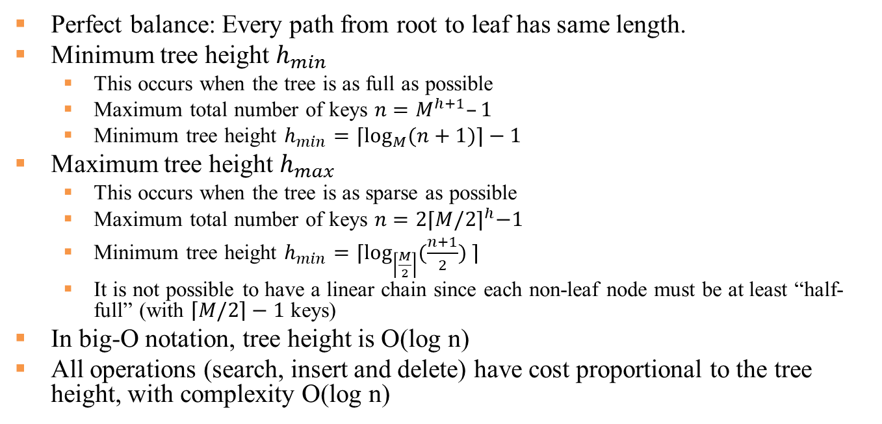
Height of an M-way B Tree
Perfect balance: Every path from root to leaf has same length.
Minimum tree height $h_{min}$
This occurs when the tree is as full as possible
Maximum total number of keys $n=M^{h+1}–1$
Minimum tree height $h_{min}=⌈\log_{M}(n+1)⌉−1$
Maximum tree height $h_{max}$
This occurs when the tree is as sparse as possible
Maximum total number of keys $n=2{⌈M/2⌉}^{h}−1$
Minimum tree height $h_{min}=⌈\log_{\left\lceil \frac{M}{2}\right\rceil }(\frac{n+1}{2}) ⌉$
It is not possible to have a linear chain since each non-leaf node must be at least “half-full” (with $\left\lceil M/2\right\rceil −1$ keys)
In big-O notation, tree height is O(log n)
All operations (search, insert and delete) have cost proportional to the tree height, with complexity O(log n)
 | Best case | Average case | Worst case
BST | O(1) | O(log n) | O(n)
BTree | O(1) | O(log n) | O(log n)
Notes:
2. Each node has at most M children (contains at most M – 1 keys)
3. Each non-leaf node (except the root) has at least ⎡M / 2⎤ children (contains at least ⎡M / 2⎤-1 keys) (i.e., must be at least “half-full”)
Each node has at most M children (contains at most M – 1 keys)
3. All non-leaf nodes (except the root) have at least ⎡M / 2⎤ children (contains at least ⎡M / 2⎤-1 keys) (i.e., must be at least “half-full”)

Slide 35
Reasons for using B-Trees
B-Trees are always balanced, i.e., all leaf nodes are at the same level
The cost of each disk read is high but does not depend much on the amount of data transferred, if consecutive keys are transferred and they fit within a memory page
e.g., M=101 and h = 3 → 101⁴ – 1 (~100 million)
A B-tree of order M=101 and height 3 can hold ~100 million keys, and any key can be accessed with 3 disk reads (assuming each node fits within one memory page)
Notes:
If we use a B-tree of order 101, then each node fits within one memory page, and we can transfer each node in one disc read operation

Slide 36
Comparing Trees
Binary trees
Can become unbalanced and lose their good time complexity (big O)
AVL trees are self-balancing BSTs
Heaps are balanced but only prioritise (not order) the keys
Multi-way trees
B-Trees can be M-way
2-3 tree is 3-way B-Tree. It approximates a balanced BST, replacing the AVL tree’s balancing operations with insertion and (more complex) deletion operations
Notes:
Proposition. A search or an insertion in a B-tree of order M with N keys requires between log _{M-1} N and log _{M/2} N probes. Pf. All internal nodes (besides root) have between M / 2 and M - 1 links.

Slide 37
Balanced Trees in the Wild
Red–black trees are widely used as system symbol tables, as data structure stored in main memory.
Java: java.util.TreeMap, java.util.TreeSet.
C++ STL: map, multimap, multiset.
Linux kernel: completely fair scheduler, linux/rbtree.h.
Emacs: conservative stack scanning.
B-tree variants. B+ tree, B*tree, B# tree, …
B-trees (and variants) are widely used for file systems and databases, as data structure stored on disk.
Windows: NTFS.
Mac: HFS, HFS+.
Linux: ReiserFS, XFS, Ext3FS, JFS, BTRFS.
Databases: ORACLE, DB2, INGRES, SQL, PostgreSQL.

Slide 38
References
Understanding B-Trees: The Data Structure Behind Modern Databases, Spanning Tree
https://www.youtube.com/watch?v=K1a2Bk8NrYQ
The example is a 3-5 tree
The Most Elegant Search Structure | (a,b)-trees, Tom S
https://www.youtube.com/watch?v=lifFgyB77zc
(a,b)-tree: a= ⎡M / 2⎤ , b=M>=2a-1=2 ⎡M / 2⎤-1
The example is a 2-4 tree
B Tree tutorials
https://spetriuk.github.io/algorithms/B-Tree.%201.%20Introduction/
https://spetriuk.github.io/algorithms/B-Tree.%202.%20Insert%20Operation/
Notes:
https://spetriuk.github.io/algorithms/B-Tree.%203.%20Delete%20Operation/
Lecture - 13 Trees, nptelhrd
Lecture - 16 Disk Based Data Structures (talks about B trees)
https://www.youtube.com/watch?v=VbVroFR4mq4
Lecture - 15 Insertion in Red Black Trees (talks about 2-3 trees)
https://www.youtube.com/watch?v=6QOKk_pcv3U
10.2 B Trees and B+ Trees. How they are useful in Databases, Abdul Bari
https://www.youtube.com/watch?v=aZjYr87r1b8
B-Tree Indexes, Ivan talks about computers
https://www.youtube.com/watch?v=NI9wYuVIYcA

Slide 39
Data Structure Visualizations
AVL Tree
https://www.cs.usfca.edu/~galles/visualization/AVLtree.html
Red/Black Tree
https://www.cs.usfca.edu/~galles/visualization/RedBlack.html
B Tree
https://www.cs.usfca.edu/~galles/visualization/BTree.html

